Slide 1





Analysis of Financial Data using Data Mining Techniques
Instructor – Vanessa Klotzman

Slide 2
Data! Data! Data!
Can’t make bricks without clay
-Sherlock Holmes

Slide 3



Overview
Let’s start with the first set of slides

Slide 4
Presentation Overview
Brief Intro
Related Work
DM Techniques we used
Results
Pros and Cons
Applications and Arguments
Conclusions drawn
References

Slide 5
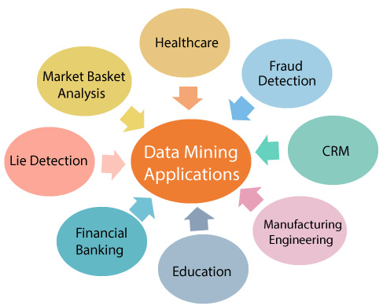
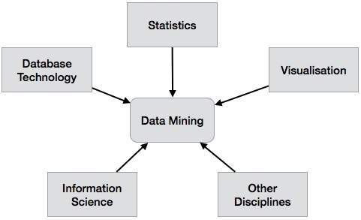
Data Mining?
Data mining is the process of analyzing and extracting knowledge from datasets. It involves various techniques such as machine learning, statistics, and artificial intelligence to identify patterns, correlations, and anomalies within the data.

Slide 6
Stages of Data Mining
Pre - Processing
Involve the cleaning and preparation of financial data to ensure that it is suitable for analysis. This could include the removal of missing or inconsistent data, the normalization of data, and the conversion of unstructured data into structured data.
1
Feature Selection
Feature selection is an important step in data mining that can improve the accuracy, efficiency, and interpretability of the model by selecting the most relevant and informative features..
2
Modelling
Its more like training and evaluation of models that are used for prediction
3

Slide 7








Data Mining in Finance

Slide 8
Data Mining in Finance
Financial Market Analysis
Data mining can be used to analyze financial market data, such as stock prices, interest rates, and currency exchange rates, to identify trends and forecast market movements.
Stock Price Prediction
Data mining can be used to analyze historical stock prices and other financial indicators to predict future trends and make investment decisions.

Slide 9
More in Finance
Portfolio Optimization
Data mining can be used to optimize investment portfolios by analyzing risk and return factors, and selecting the best combination of assets.
Risk Analysis
Data mining can be used to assess the creditworthiness of borrowers by analyzing their financial history, credit score, and other factors.
Fraud Detection
Data mining can be used to detect fraudulent activities such as credit card fraud or money laundering by identifying unusual patterns or outliers in financial transactions.

Slide 10

A picture is worth a thousand words
In data mining it’s not the same

Slide 11

Data Mining for Stock Value Prediction

Slide 12
Data mining can be used to predict the “closing value” of a stock by analyzing historical stock data and other related financial information.
It is important to note that stock prices are influenced by a wide range of factors, such as
economic conditions
market trends
geopolitical events

Slide 13

About Dataset
Index | Column | Non-Null | Data Type
0 | Date | 851264 | Object
1 | Symbol | 851264 | Object
2 | Open | 851264 | Double
3 | Close | 851264 | Double
4 | Low | 851264 | Double
5 | High | 851264 | Double
6 | Volume | 851264 | Double

Slide 14
Roadmap
Data Collection: Pandas is a popular data manipulation library in Python that provides powerful tools for importing and working with structured data.
Descriptive Analysis:
Such as Univariate/Bivariate/ Multivariate analysis to explore the outliers, correlation for particular stock
Training the regression model/ NN model/ XG Boost model
1
3
5
2
4
6
Exploratory Data Analysis:
the process of analyzing and summarizing data to gain insights and identify patterns, relationships, and anomalies
Data normalisation and splitting of the data to train and evaluate the model
Evaluation and comparison of models in terms of accuracy and precision

Slide 15
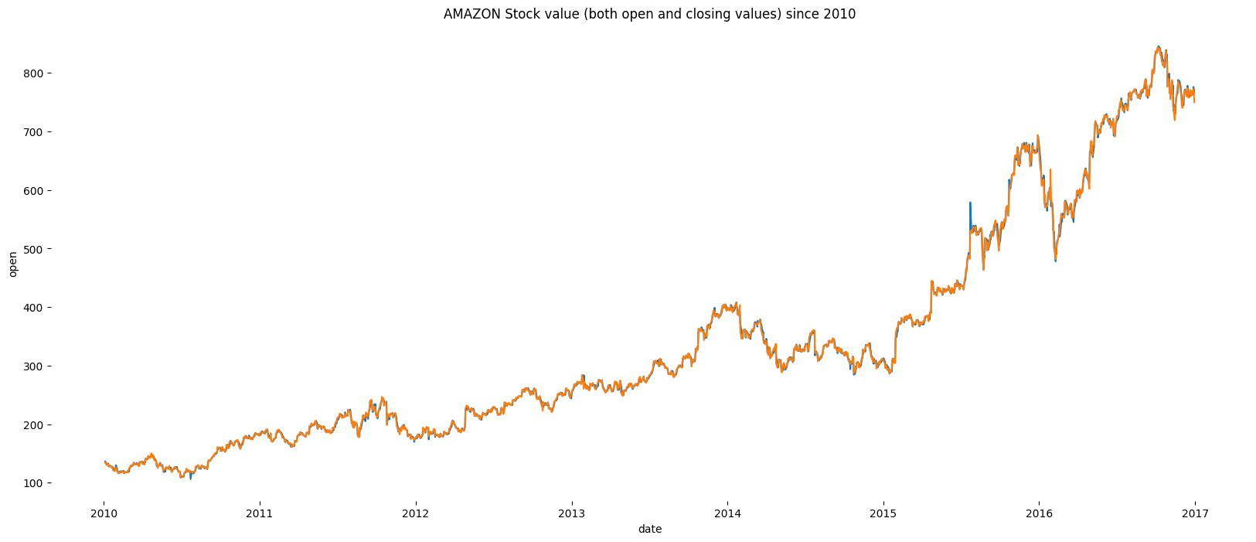
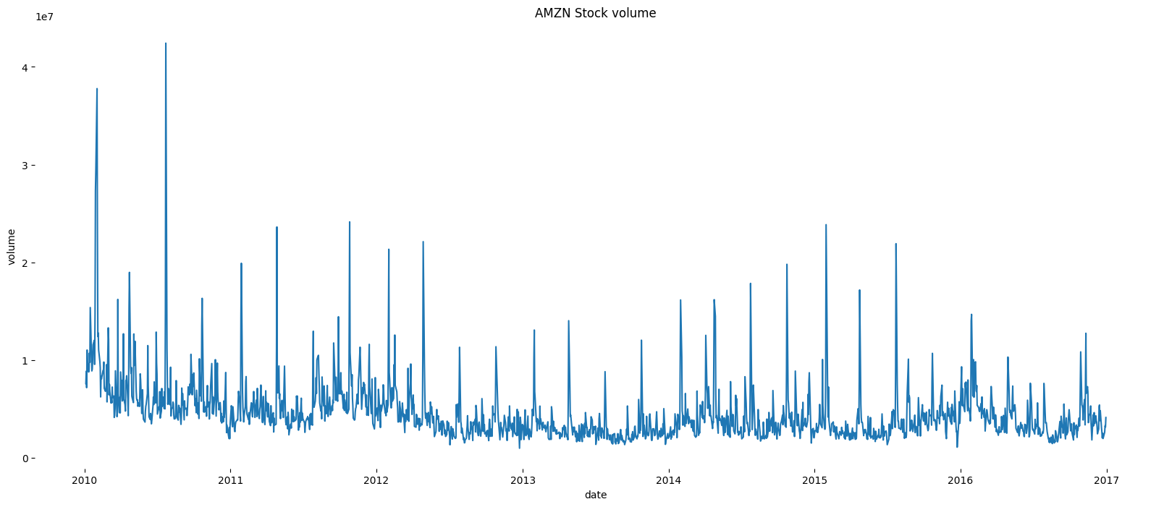
Stock Value and Volume for AMAZON stock

Slide 16
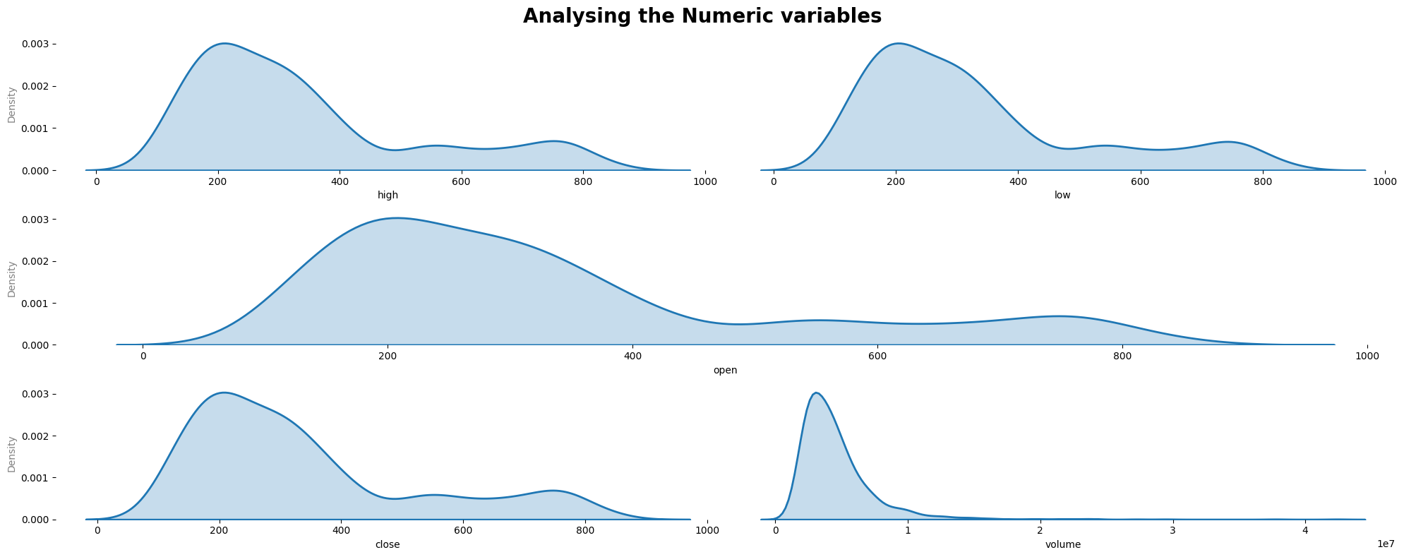
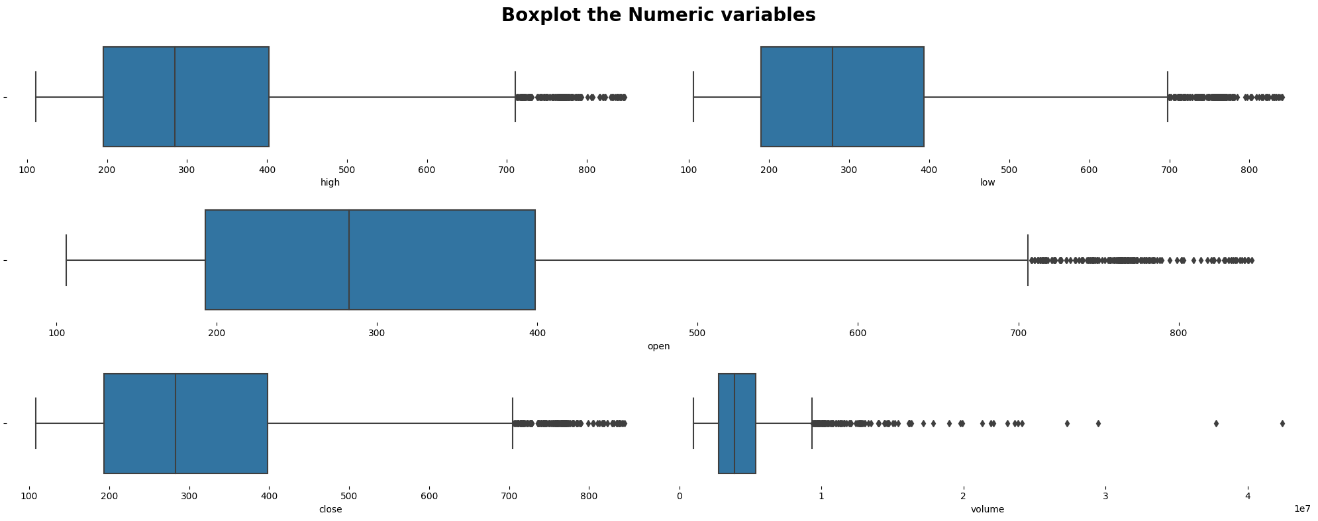
Checking for Skewness
-- all are right-skewed
Checking for Outliers
--seems to have few outliers which is common in stock data

Slide 17
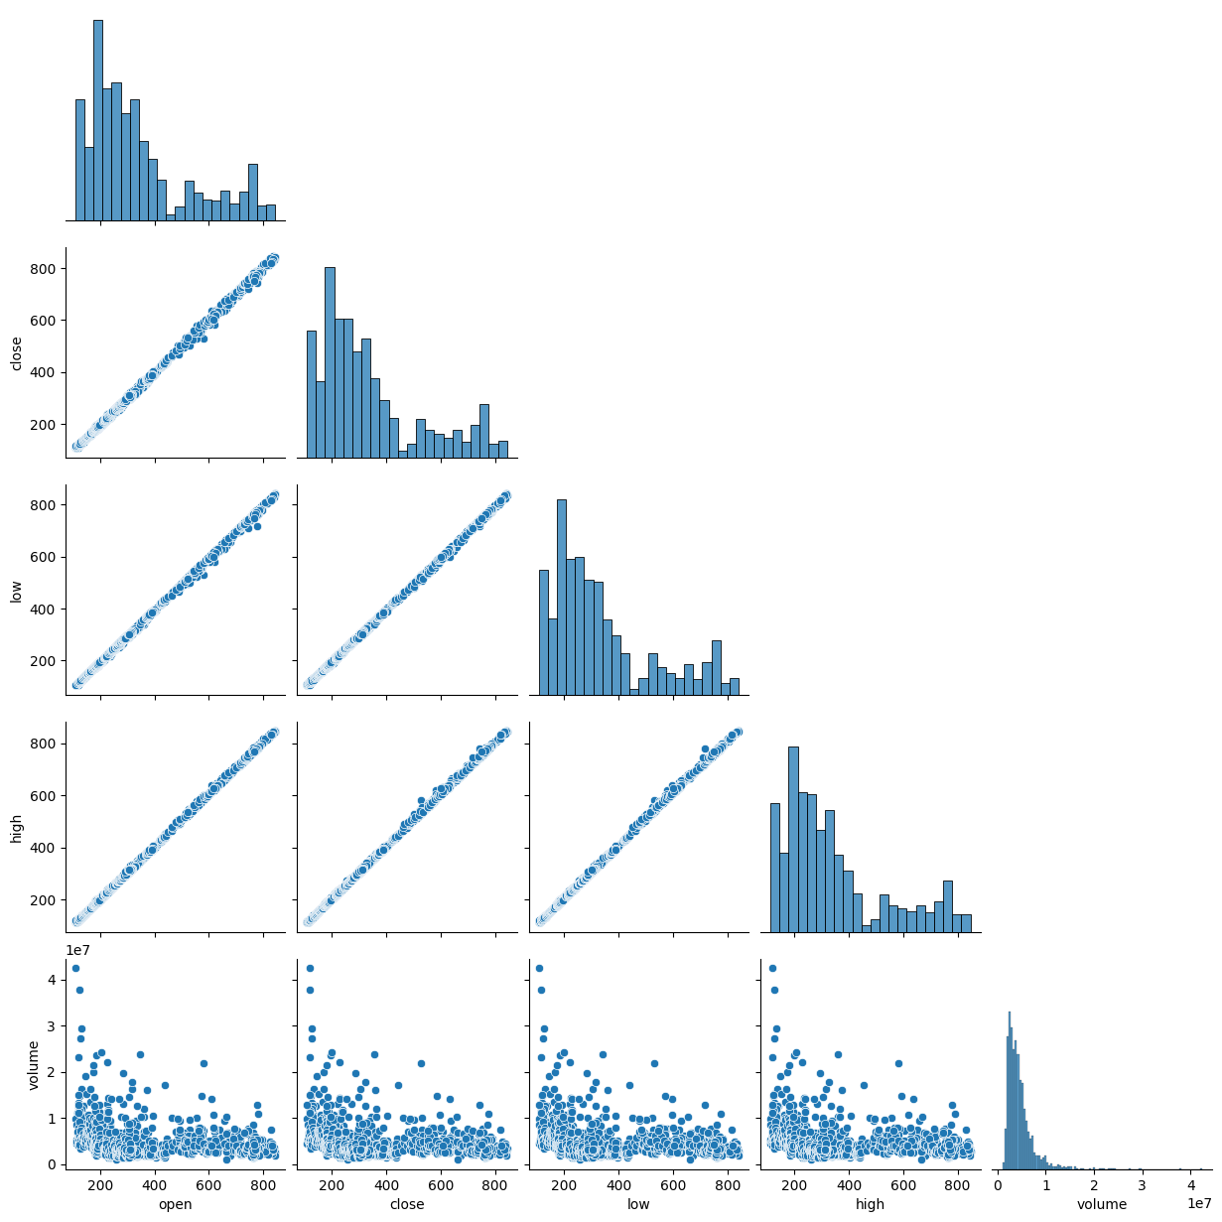
Correlation using pair plots
Correlation w.r.t ‘close’
open 0.999581 close 1.000000 low 0.999832 high 0.999811 volume -0.238560
We are considering the target feature as “close”. As we require to predict the closing value of a stock

Slide 18
Let’s review some modeling
Regression Analysis
Linear regression is a widely used machine learning algorithm in data mining that predicts a continuous numerical output variable based on one or more input variables. In linear regression, the relationship between the input and output variables is assumed to be linear, and the goal is to find the best fitting line that describes this relationship.
Ensemble learning
XGBoost (Extreme Gradient Boosting) is a popular machine learning algorithm in data mining that is used for regression and classification tasks. XGBoost is an ensemble algorithm that combines the predictions of multiple decision trees to improve the accuracy and robustness of the model.
Neural Networks
An Artificial Neural Network (ANN) is a machine learning algorithm that is inspired by the structure and function of biological neurons in the brain. ANNs are used in data mining for various tasks such as classification, regression, pattern recognition, and prediction.

Slide 19
Hyper Parameters
In theory, there might be hyper parameters such as intercepts, weights etc.
But we are discussing the hp’s that are in the implementation part
Such as number of layers, input cells, activation function, epochs

Slide 20
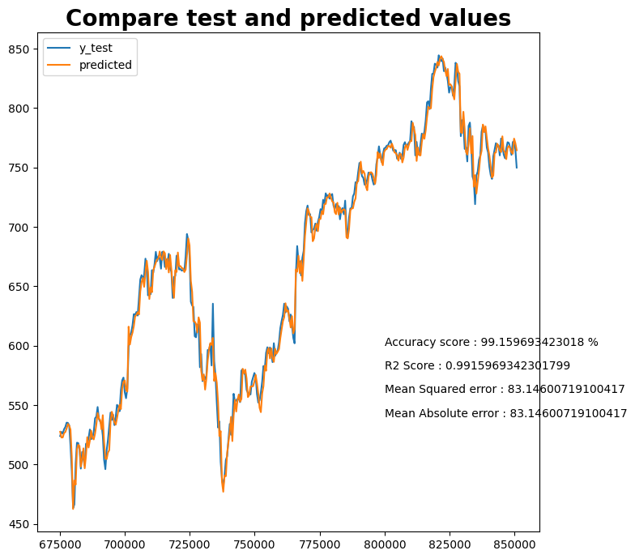
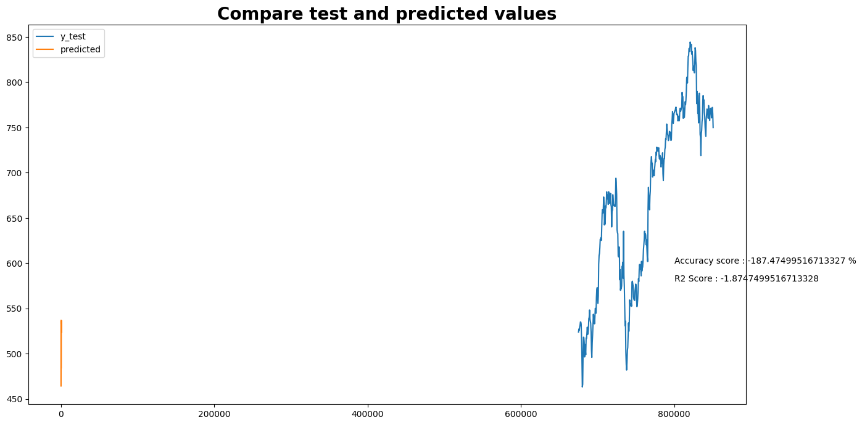
Results
XG Boost
Linear Regression

Slide 21
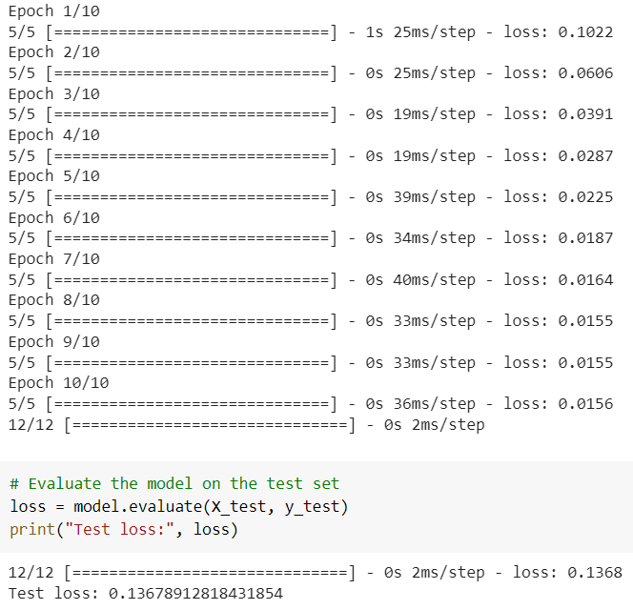
ANN
RESULTS

Slide 22
Advantages
Accuracy
Improved accuracy when compared to the exsiting system
Scalable
Able to analyze large amount of datasets
A
S
Increased interpretability of results and provide clear insights for organizations
Interpretability
Increase in transparency and let organizations to identify potential risks
Transparency
I
T

Slide 23
Minor Disadvantages
Larger the data – higher the execution time
Plausible risk function results (MSE/R-squared)
Cannot predict for all the stocks at once.

Slide 24

Applications
Investment Decisions
Risk Management
Business Planning and Stratagies
Financial Forecasting
Fraud Detection

Slide 25
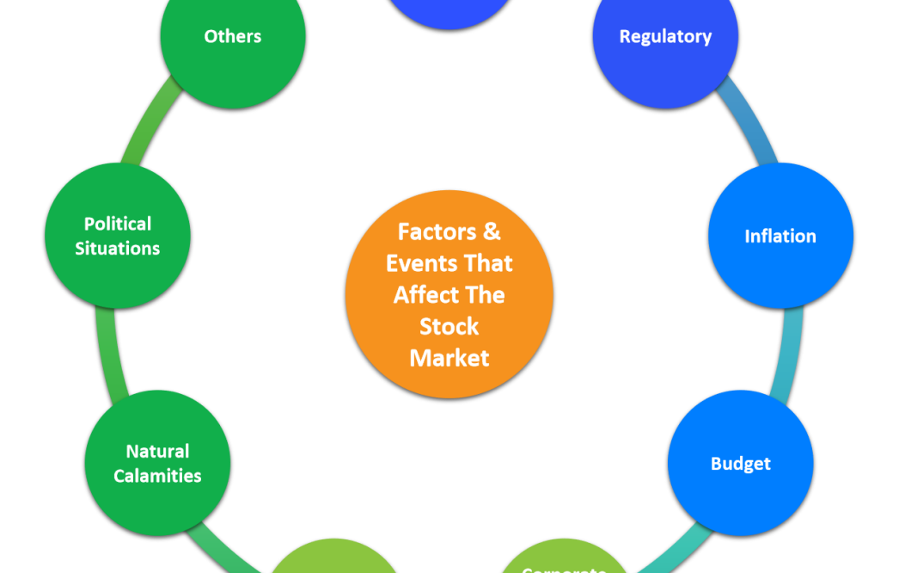
Discussion
As we mentioned in the earlier slides, there are different factors that can effect the stock values, so there is a chance of including such other factors to the data for much efficient prediction

Slide 26
Further Extension
Apart from what we mentioned in discussion, thus far we are predicting the stock value with the data which is already present.
In order to extend, we can design an UI where we can provide present day’s opening high and low values of stock to predict the closing value of the stock

Slide 27

To End it…!
From our analysis it is good to say that regression models are highly effective in predicting the stock values with higher accuracy, but it is not to neglect the other popular models like NN and XGB which are having good accuracies as well.

Slide 28
Credits
Model Selection for Financial Statement Analysis (IEEE Explore)
Stock Prediction and Analysis Using Intermittent Training Data With Artificial Neural Networks (IEEE Explore)
Stock market prediction by applying big data mining (Arab Gulf Journal)
https://www.kaggle.com/code/gcmadhan/amazon-stock-prediction-nn-fbprophet/input?select=prices.csv

Slide 29




Done by!!!
Sai Poojitha
M.S. , C.S.
Bhargavi M.S. , C.S.
Guru Vishnu M.S. , C.S.
Surya Teja M.S. , C.E.

Slide 30

Thanks!
Any questions?

